Slide 1





TWEMOJI
Predicting Emojis from Tweets
CS3244 TEAM 22
Andrew | Anvitha | Benedict | Charisma | Chin Juan | Vaishnavi
Notes:
Hi there and welcome to our project Twemoji. In this project, we used machine learning to predict emojis based on the text in Tweets

Slide 2
Table of Contents
Twemoji Dataset
Data Pre-
Processing
Word Embeddings
Model Building
Model Evaluation
Team Reflections
🐥
🧹
🎒
👷‍♀️
💯
👨‍🎓
Notes:
I’ll first be introducing our dataset, and then we’ll discuss the pre-preprocessing, word embeddings, the models built, their evaluation as well as our final reflections.

Slide 3

01
Twemoji Dataset
Introduction

Slide 4
Problem Statement 🤔
1
2
3
How can we recommend emojis such that Twitter users do not have to spend time searching for relevant ones for their tweet?
How can we predict the most appropriate and context-specific emojis?
If Twitter were to introduce a quick-react emoji feature like many other applications, how can we further enhance it by recommending relevant emojis in response to a tweet?
Notes:
Let us first discuss our problem statement, which could be divided into 3
Firstly, how can we recommend emojis for tweets so that users don’t have to spend time to find it themselves
Secondly, how can we ensure that we predict the most appropriate emoji depending on the context
And thirdly, if Twitter got a new reaction feature, how could we recommend emojis in response to tweets

Slide 5
Twemoji Dataset 🐥
Source: Amsterdam University of Applied Sciences and published in February 2018 https://uvaauas.figshare.com/articles/dataset/Twemoji_Dataset/5822100
Features: Collection of 13 million tweets (instances) consisting of features like tweets IDs, emoji annotations and image URLs if an image was attached
Reliability: The dataset is largely reliable with 3400 downloads and 2 citations.
Notes:
Now let us try and understand the Twemoji dataset. This was published by Amsterdam University in 2018 and contains over 13 million tweets. However, this dataset is imbalanced, and the number of tweets for each emoji varies significantly

Slide 6
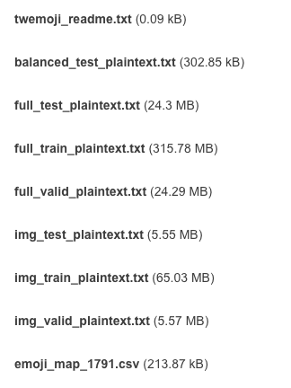
Twemoji Dataset 🐥
Balanced version of the full test set
Main dataset
2 Columns: Tweet id, annotations
Split into train, test and validation sets
Subset of main dataset of tweets with images.
3 Columns: Tweet id, annotations, image URL
Split into train, test and validation sets
Mapping of the 1791 emoji ids to their metadata
Notes:
The dataset consisted of the files shown here. These files were the main dataset which consisted of the tweet Id and the emoji annotations, and were split into train, test and validation.
This one is a subset of the main dataset, which included a third column for image URLs.
Then we have a balanced version of the test set and lastly a mapping of the 1791 ids used for emojis with their metadata.

Slide 7
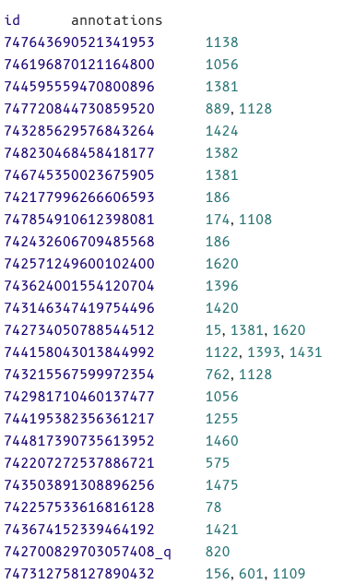
Twemoji Dataset 🐥
Some attributes of the plaintext file that we have to note:
Some tweets have multiple labels (contain more than 1 emoji)
Some tweets are quoted tweets, they are identified by ‘_q’ at the end of the tweet id
Notes:
Some points to note about the main dataset files are that
There are some tweets that are tagged with multiple emojis as seen by more than one id under annotations, and some tweets are quoted reply tweets, and they can be identified with the underscore q after the tweet id

Slide 8

Data Cleaning 🧹
Remove tweets that have multiple distinct annotations
eg.[⏰🐷✈️] → When pigs fly
Remove quoted tweets
Drop emojis that are not used in all 3 dataset split (train, test, validation)
Notes:
Before we retrieved this dataset, we cleaned it by removing tweets that have multiple distinct emojis, since a string of emojis could be used to tell an entire story and can get complex
Secondly we removed the quoted tweets, as they are more like comments rather than original tweets, and hence need context.
Lastly, we dropped those emojis that weren’t used in all 3 train test and validation sets.

Slide 9
02
Data Retrieval and Pre-Processing

Slide 10
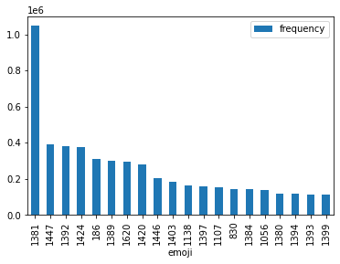
Top 20 Emojis 🔝
😂
After cleaning, we selected the top 20 frequent emojis.
Initially, we wanted to use all 20 emojis, but due to
1) similarity between emojis
2) scale of project,
We decided to focus on 5 emojis before training
🙄
😍
😭
❤️
😊
🤔
😩
🙃
😘
💯
😒
💕
👀
😅
💀
😁
😏
😎
😔
Focus: ❤️(186), 😂 (1381), 😅 (1384), 😍 (1392), 🙄 (1447)

Slide 11
Dataset Download ⬇️
Tweepy Library: Using Twitter Developer accounts, we downloaded subsets of the dataset of the 5 emojis that we are using (80,000 for train, 10,000 for validation and test)
Issues: Not all tweets could be downloaded as some tweets could no longer be found (private account/deleted tweets)
Topping up of dataset: To balance the dataset, we topped up the ones with a lot of missing data from a similar emoji dataset - EmoTag (https://github.com/abushoeb/EmoTag)
Notes:
Talk about the imbalance in the data

Slide 12
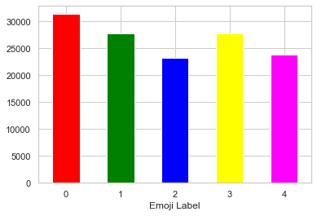
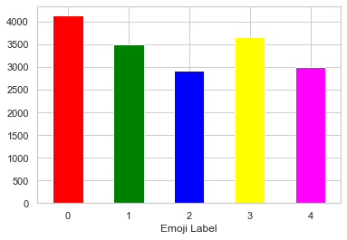
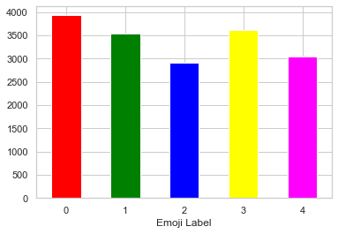
Distribution of Final dataset 📊
TRAIN
VALIDATION
TEST
Emoji Mapping: 0 - ❤️ 1 - 😂 2 - 😅 3 - 😍 4 - 🙄

Slide 13

Data Pre-Processing
Tokenization (Tweet Tokenizer)
Stopwords Removal (NLTK Corpus)
1)
Converting words to lowercase
Removing non-alphanumeric tokens (Regex)
Lemmatization
2)
Delete characters with
non English ASCII values
3)

Slide 14
03
Word Embeddings
Techniques explored before model building
Notes:
(For this project, we are doing text classification that requires features to be learnt from the words and word embeddings can help with that and we can then map it to an 7emoji here. The idea behind is that the embeddings represent each word as a real-valued vector, and similar words will have similar representation or are closer in a vector space. So by this, the models can learn the meaningful relationships between words.).

Slide 15

Initial Considerations for word embeddings
BoW
N-grams
TF-IDF
GLoVe
Creates one-hot vector that describes the occurrence of words within a corpus
Encodes the co-occurrence probability ratio between two words as vector differences.
Represents a sub-sequence of n-words and produces probabilities of a word occurring after one.
Uses statistical measure used to determine the mathematical significance of words in a corpus
Notes:
(When experimenting with what kind of embeddings to use, we had 4 different types of them explored. The most simple types are the bag-of-words and n-grams as taught in the lecture. However, Bag of words does not consider order or grammatical structure of a word and n-grams does not strongly capture the context of words, so they were not the most appropriate for the sparse tweet data we had.)
is similar to N-grams and BoW in that it uses a statistical measure of how frequent words are in a sentence, determines its significance for the label by its frequency in the overall document. It does not consider co-occurrence or semantics. And this is where GloVe enters. It considers the occurrences and co-occurrences of words and projects them into a matrix that would help the model learn semantic similarity.
.It creates a one-hot vector that describes the occurrence of of words in a corpus, but it does not consider order or structure of words so it was not the most appropriate for our task. N-grams counters the limitations of BoW. The n-grams embedding represents a sub-sequence of n-words and then produces probabilities of a word occurring after another. However, it does not strongly capture the context of words that are much more far apart and for our tweets especially since they are sparse data.
combines all the different senses of the word into one vector
TFIDF - focuses more on how important a word is to a document. Counts how many times does a word occur in each message (Known as term frequency) and Weigh the counts, so that frequent tokens get lower weight (inverse document frequency)
ELMo and BERT can generate different word embeddings for a word that captures the context of a word - that is its position in a sentence
Glove preferred coz it is a task that can benefit from the semantic similarity captured by word embeddings

Slide 16

Final Word Embeddings Used
TF-IDF
GLoVe
Notes:
(So we ended up choosing TF-IDF and GloVe to compare our models against since the embeddings are different in terms of how they make sense words. We can examine whether context means a lot for the emoji to be predicted right, or if the model can make do with understanding the importance of a particular word. GloVe has also been used and reference in many of the emoji-prediction work done previously and has produced good results.)
Explain why you didn’t use BoW or Bag of ngrams.
Bag of Words just creates a set of vectors containing the count of word occurrences in the document (reviews), while the TF-IDF model contains information on the more important words and the less important ones as well→ hence tf-idf is better
Can mention how Glove was the most common embedding used in text classification and produced good results. Reference the articles, research papers used. Same with TFIDF.
Can mention that you wanted to examine how different embeddings affect model performance in predicting the emojis.

Slide 17
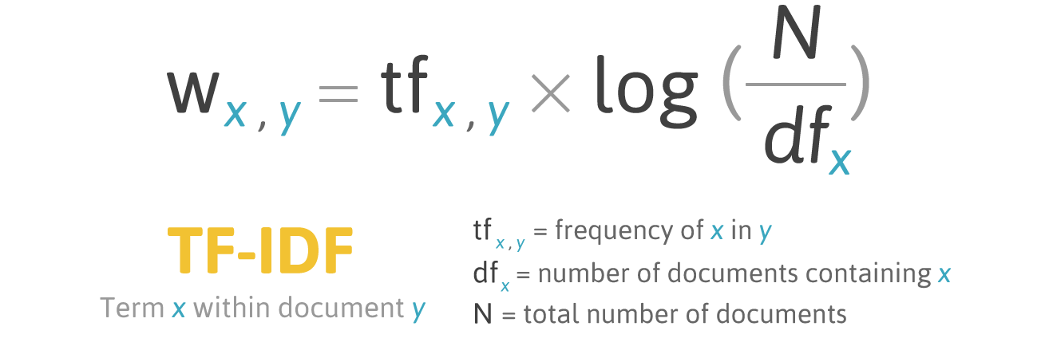
TF-IDF
Word embedding technique used by multiplying the term frequency and inverse document frequency
IDF =Log[(# Number of documents) / (Number of documents containing the word)] and
TF = (Number of repetitions of word in a document) / (# of words in a document)
We used sklearn’s TfidfVectorizer to vectorize the words in our tweet list
Notes:
(So let me elaborate on the embeddings. TFIDF computes the frequency of a word in sentence and also in relation to the entire document. The measure is as specified here in this formula. So common words have a lower close while the unique words have higher score which means they are more relevant to the document. Through this, we can detect how important a word is to a document in a corpus and can be used to predict emojis w.r.t to the entire tweet. )
For example, if the word is very common and appears in many documents, this measure will approach 0. Or else, it will approach 1. higher the score is, the more relevant that word is in that particular document.
y evaluating TF-IDF or a number of “the words used in a sentence vs words used in overall document”, we understand -
1)how useful a word is to a sentence (which helps us understand the importance of a word in a sentence).
2)how useful a word is to a document (which helps us understand the important words with more frequencies in a document).
TF_IDF instead of only counting the occurence of a word in a single document it also does so in relation to the entire corpus. This allows us to detect how important a word is to a document in a corpus→ hence better at predicting emojis wrt to the entire tweet.
o, if the word is very common and appears in many documents, this number will approach 0. Otherwise, it will approach 1.
igher the score, the more relevant that word is in that particular document.
documents with similar, relevant words will have similar vectors,

Slide 18
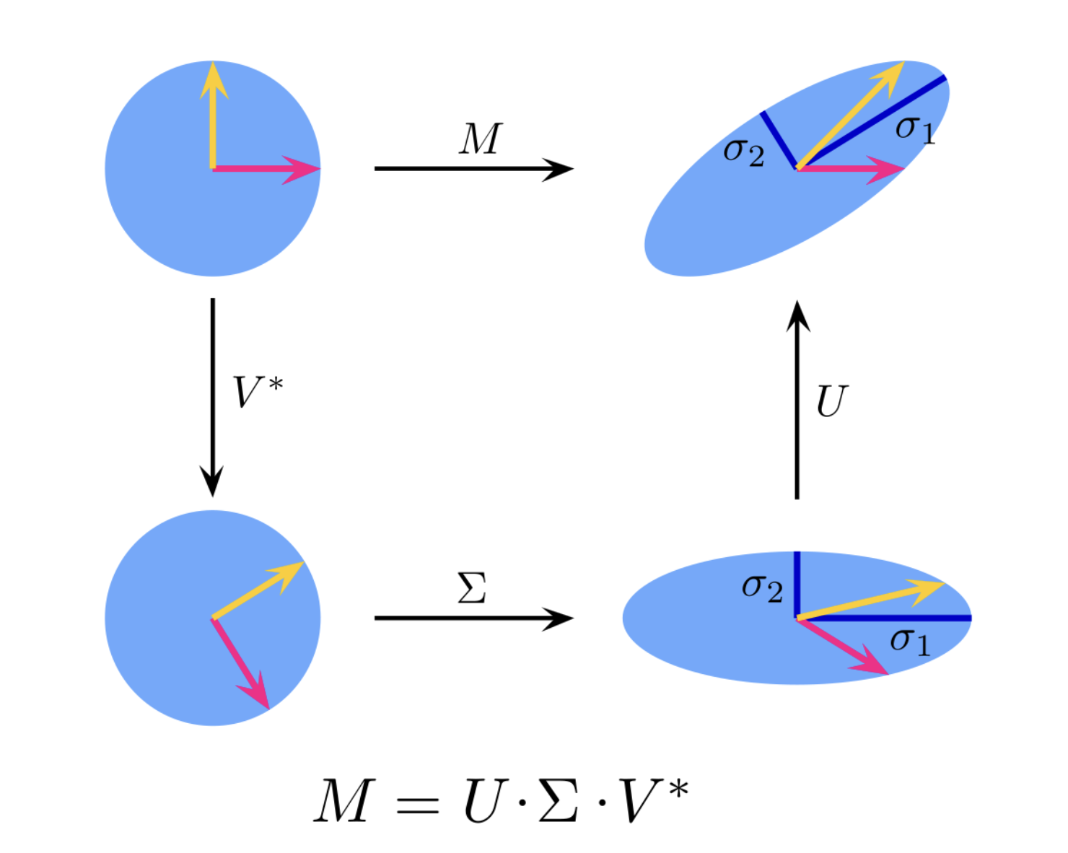
TruncatedSVD
TF-IDF comes with the Curse of Dimensionality!
SVD: TF-IDF sparse matrix => High dimension
Prevent overfitting, faster runtime
Reduced rank approximation of original matrix by setting all but the first k largest singular values equal to zero and using only the first k columns
Hyperparameter k = 300
Notes:
One disadvantage of TF_IDF is that it can produce a sparse matrix. Due to the curse of dimensionality, having too many input variables tend to lead to overfitting and slower model training. SVD is a kind of dimension reduction technique that factorizes the sparse matrix by TFIDF. It produces a matrix of lower rank that approximates the original matrix by taking only the k largest singular values. For the TFIDF embedding in our projected, we used a k value of 300.
Verma, Y. (2021, December 7). Beginners Guide to truncated SVD for dimensionality reduction. Analytics India Magazine. Retrieved November 19, 2022, from https://analyticsindiamag.com/beginners-guide-to-truncated-svd-for-dimensionality-reduction/

Slide 19
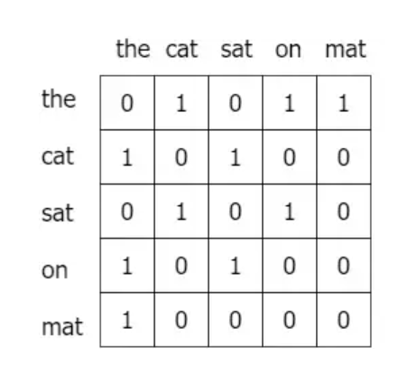
GLoVe 🧤
Word2Vec-like representation of words
Takes global word-word co-occurrence statistics from a corpus.
Computes how frequently words co-occur with one another in a given corpus.
Through co-occurrence matrix, can get semantic relationships of words.
There are 4 pre-trained models from the Stanford repo.
We went with the 100-dimensional glove vectors obtained from Tweet data.
Notes:
https://analyticsindiamag.com/hands-on-guide-to-word-embeddings-using-glove/
https://nlp.stanford.edu/projects/glove/
To elaborate on the Glove embeddings, its similar to Word2vec in the fact that each word is represented as a vector but glove takes the global context, which in our case is the entire tweet list. Glove computes the probabilities with which a word might co-occur with another throughout the entire tweet list and projects it onto co-occurrence matrix like this. Through this, it helps in solving our problem statement of a context-specific prediction of emoji.
So for our project, we used the pre-trained models released by Stanford. Among the 4 pre-trained models, we used the one trained on the Twitter corpus, that contains 21 billion tokens of 100 dimension.
Now that the embedding layer is elaborated, I will pass over my time to Benedict who will describe the different machine learning models we experimented with.

Slide 20
04
Model Building

Slide 21
Models Considered
01
SVM
02
Logistic Regression
03
Random
Forest
04
Simple NN
05
CNN
06
BiLSTM
07
BerTweet
08
DistilBert
Notes:
Vaish- Bi-LSTM
CJ- SVM + documentation
Anvi - Distil Bert
Benedict- Logistic regression + documentation
Charisma - Random Forest
Andrew- CNN

Slide 22
Linear Models used
SVM
Logistic Regression
Random Forest
SVM aims to find optimal boundary between possible outputs. SVC is used to have multiclass support.
Multinomial logistic regression is used to support multiple possible classes.
Ensemble method for classification that operates by constructing a multitude of decision trees at training time

Slide 23
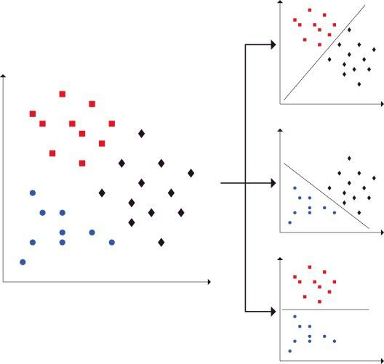
Support Vector Machine ➰
Support Multiclass Classification
SVM in its base form only linearly separates between 2 classes
To support multiclass classification, we used C-Support Vector Classification, which handles multiclass by a one-vs-one scheme.
One-vs-One Scheme
One-vs-One works by generating N *(N-1) / 2 binary classifier models.
Essentially, we are creating 1 binary model for every pair of class we have to perform binary classification
Image credits to https://www.sciencedirect.com/science/article/abs/pii/S0950705116301459
Notes:
Can mention:
Realized the NNs were taking extremely long to run (2hrs for 1 epoch) and SVM timed out.
So we decreased the number of emojis to 10 instead of 20 and used those emojis that are more frequently used and are distinct.
TF-IDF produced lesser accuracy compared to Glove. 38% : 44%
Do an analysis of the confusion matrices. What you infer from them.

Slide 24
Support Vector Machine ➰
Other considerations
We used the default kernel type: rbf
As the training time for SVM was very long, we didn’t manage to do hyperparameter tuning using other kernel types
To simplify the representation of the glove embeddings of a sentence for linear models, np.mean() is used to get a single value per sentence. However this will result in us ignoring the 3D representation of a sentence.
Notes:
Can mention:
Realized the NNs were taking extremely long to run (2hrs for 1 epoch) and SVM timed out.
So we decreased the number of emojis to 10 instead of 20 and used those emojis that are more frequently used and are distinct.
TF-IDF produced lesser accuracy compared to Glove. 38% : 44%
Do an analysis of the confusion matrices. What you infer from them.

Slide 25
Logistic Regression 📉
Multinomial Logistic Regression
Classification method that generalises logistic regression to multiclass problems.
Hyperparameter Tuning
Done using different solvers and C values
Solvers = [‘newton-cg’, ‘lbfgs’, ‘sag’, ‘saga’]
C_values = [100, 10, 1.0, 0.1, 0.01]
Penalty = “l2”
Best combination: [‘newton-cg’, 1.0, ‘l2’]
Other Considerations
To simplify the representation of the glove embeddings of a sentence for linear models, np.mean() is used to get a single value per sentence. However this will result in us ignoring the 3D representation of a sentence.

Slide 26
Random Forest 🌳
Decision Tree Variants
Tried various models like decision trees, random forest, gradient boosting, adaptive boosting and extra trees: Random forest had the best results, probably because of noisy data and the objective of multiclass classification
Random Forest
Ensemble learning method that constructs a multitude of decision trees at training time.
By having an ensemble, we are able to do majority voting and other bootstrapping techniques which decreases the variance of the model, by not relying too much on a single decision tree that can be highly sensitive to noise in the training set and can overfit to it

Slide 27
Random Forest 🌳
Hyperparameter Tuning
criterion = [‘gini’, ‘entropy’]
max_features = [None, ‘sqrt’, ‘log2’, 0.2, 0.5]
max_depth = [10, 20, … 120]
n_estimators = [10, 20, 50, 100, 200, 500]
Best combination: {entropy, log2, 95, 500}
Other Considerations
To simplify the representation of the glove embeddings of a sentence for linear models, np.mean() is used to get a single value per sentence. However this will result in us ignoring the 3D representation of a sentence.

Slide 28
Neural Networks
Simple Neural Network
CNN
BiLSTM
Baseline model for us to compare our deep NN models against
CNNs are able to capture the general context of the whole sentence due to the convolution layers
A type of RNN architecture that is used to reduce the effects of the vanishing gradient problem

Slide 29
Simple Neural Network
Our simple neural network has three alternating layers of dense neurons and dropouts.
Input
Embedding
Dense + ReLU
Dropout 0.5
Dense + ReLU
Dropout 0.25
Dense + ReLU
Dropout 0.25
Output

Slide 30
CNN
Our convolutional neural network utilises 2 convolution layers with a max pool in between, before flattening to get the result
Input
Embedding
Convolution
MaxPool
Convolution
Flatten
Dense + ReLU
Softmax
Output

Slide 31
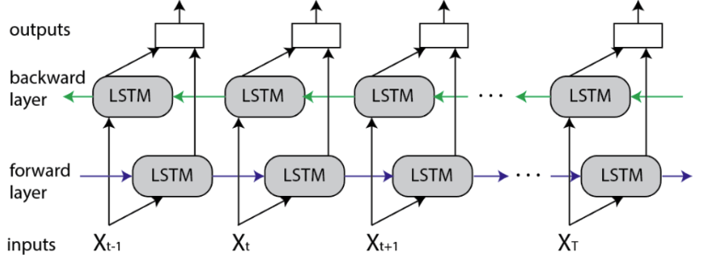
BiLSTM
Output
BiLSTM models are found to counter the vanishing gradient problem of RNNs.
Bidirectional layers allows the utilisation of information from both sides
Softmax
Fully Connected Layer
BiLSTM Layer (150)
BiLSTM Layer(150)
Embedding
Image credits to https://www.baeldung.com/cs/bidirectional-vs-unidirectional-lstm
GLoVe (or) TF-IDF
Notes:
Based on multiple research papers and articles on text classification, BiLSTM had been found to give good performance for sentiment analysis and counters the vanishing gradient problem that traditional RNNs face. So we considered it and used the 2 different word embeddings on it. The first layer is embedding layer, where the embedding layer will represent each word as a matrix. The embedding layer is loaded from a Pre-trained GLoVe model and the weight is fixed during training. This is followed by 2 bidirectional layers, and a dense layer and a softmax layer that produces a probability distribution of the predicted emoji for the sentence.
By reducing our emojis to 5, we created a more balanced distribution of the dataset with the top 5 balanced classes with sufficient data, the test accuracy improved up from 25% on both embeddings.
We thought it would be helpful to use extracted features (num of words etc) along with an embedding layer to improve performance but it produced much lesser accuracy - of only 27%. This indicated that for our dataset, specifically the tweets, the features we extracted were not really related to our target output and revealed little information on their sentiments. So we went forward with using just the embeddings and we found that TFIDF produced 38% accuracy while GLOVE produced 44%.
In order to find the the optimal parameters for this recurrent neural network, we did hyperparameter tuning. However, the tuning did not produce much increase in performance, giving only 1% increase.
The performance of the LSTM model on these embeddings is not as strong and we believe that this could be because of the lack of overlap between the pretrained embeddings and the tweets.
(We only used less than <> data in total. And since the tweets are short and don’t have much overlap with Glove, we realize that the data isn’t generalizable enough to predict emojis more accurately.)
https://www.baeldung.com/cs/bidirectional-vs-unidirectional-lstm

Slide 32
Transfer Learning 🚀
Transfer learning models required lesser training data to reach optimal performance
It is faster than training a machine learning model from scratch
We downstreamed the task to fit our emoji prediction problem
Notes:
Transfer learning models required lesser training data and it is faster than training a machine learning model from scratch since the models leverage knowledge (features, weights, etc.) from previously trained models.

Slide 33
Initial Considerations for transfer learning models
BERTweet
DistilBERT
RoBERTa
BERT-base
BERTweet is the first public large-scale language model pre-trained for English Tweets.
DistilBert is a small distilled bert base model→ using 60% of the parameters used in the bert base model.
RoBERTa is a transformers model pre-trained on a large corpus of English data in a self-supervised fashion
BERT base model. Pretrained model on English language using a masked language modeling (MLM) objective

Slide 34
Final Transfer Learning models used
Bertweet
DistilBert
Notes:
Bert was taking too long to train due to the large amounts of data required→ distilbert was better since its a smaller version of bert
Given that berttweet was pretrained on english tweets it was determined to be better model for our problem since out dataset was based on tweets compared to the Roberta which was based of a general english data.

Slide 35
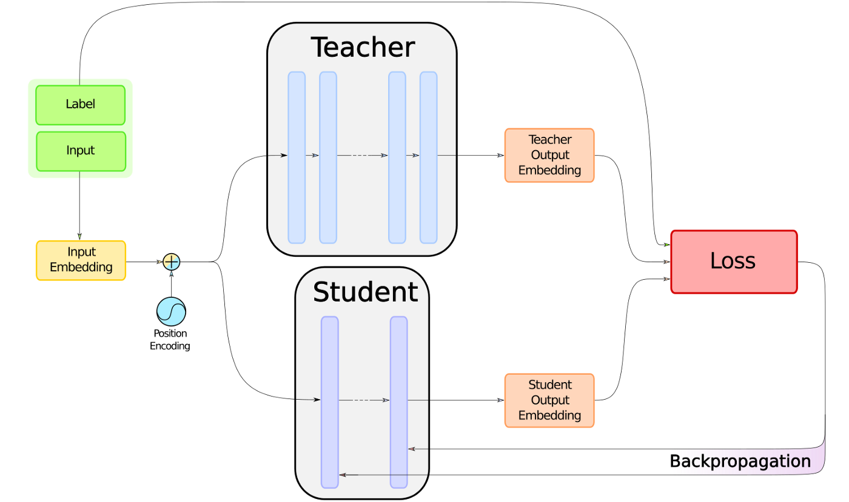
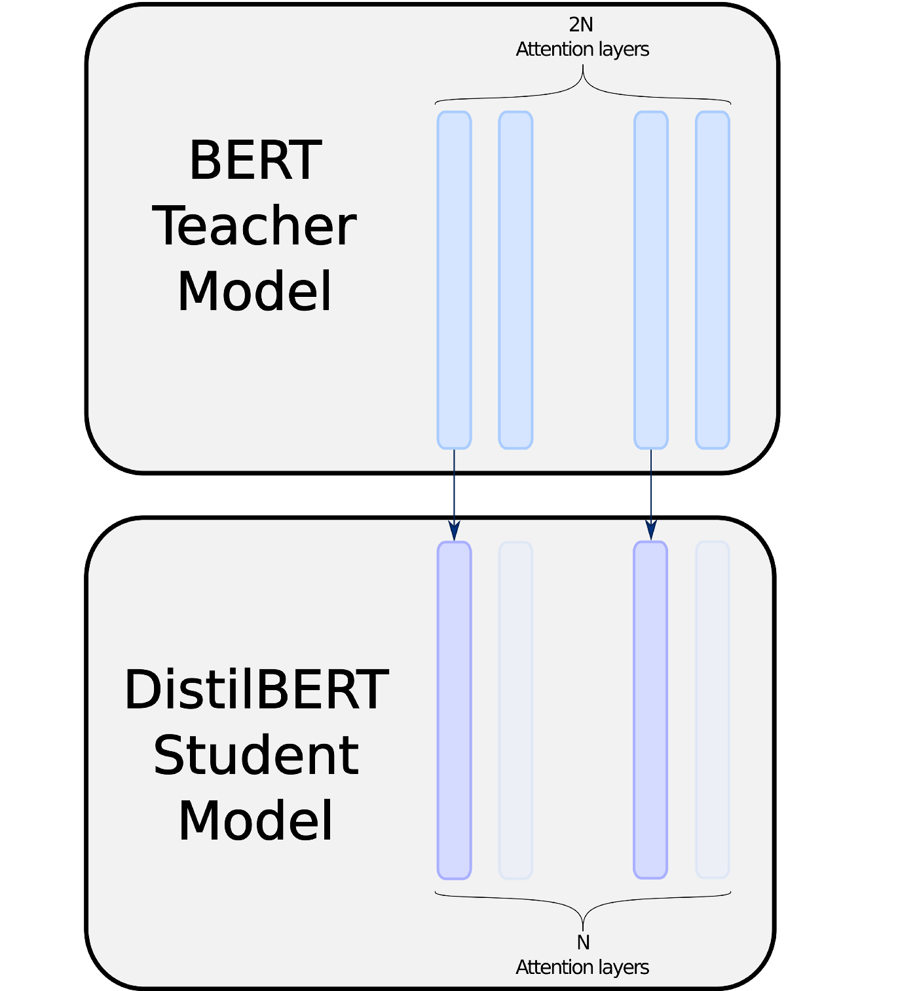
DistilBert
Focuses on distillation method to compress Bert-base model into smaller and cheaper model with 60% of parameter as compared to the original model
Notes:
First we have distilbert which Focuses on distillation method to compress Bert-base model into smaller and cheaper model with 60% of parameter as compared to the original model
Distillation is the process of training a small student model to mimic a larger teacher model as close as possible.

Slide 36
Bertweet
80GB corpus of 850M English Tweets
BERTweet, the first public large-scale pre-trained language model for English Tweets
Same Architecture as Bert-base of language model BERT
845M General English Tweets
5M English Tweets related to COVID-19
Language identification using FastText
Tokenize tweets and translate emoticons icons into text strings
Normalize and filter out tweets
Notes:
Second we have bertweet which is a language model pre trained on english tweets.
The flowchart depicts the process by which the tweets were collected and the model was trained.

Slide 37
05
Model Evaluation
Summary of model performance

Slide 38
Model Evaluation metrics
Confusion matrix
Classification report
Notes:
Give reasoning to why you think linear models did not work the best.

Slide 39
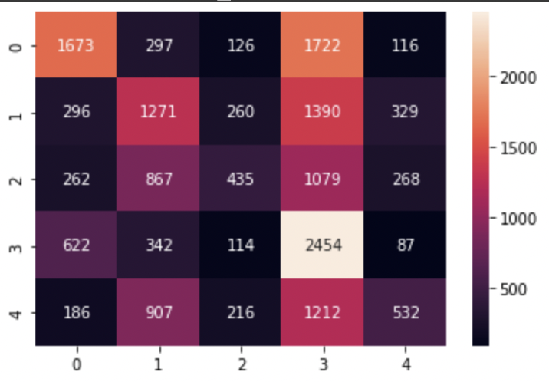
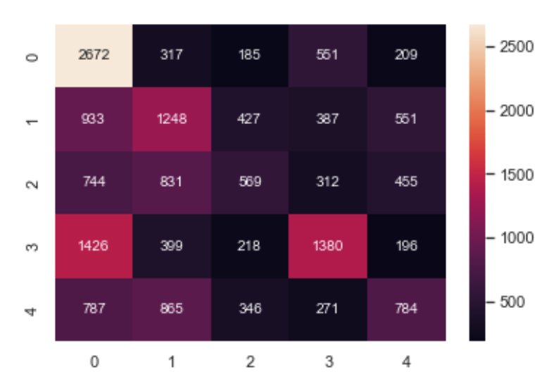
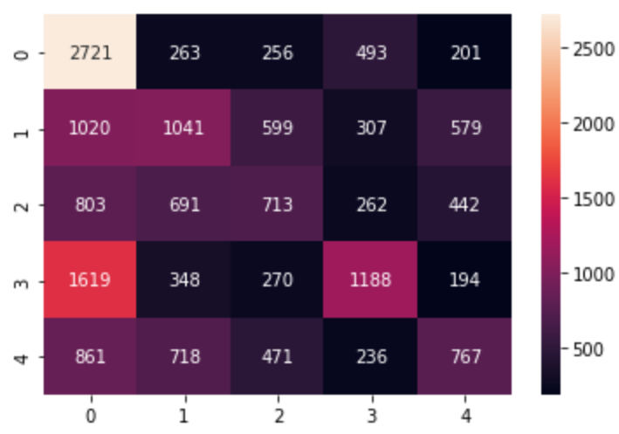
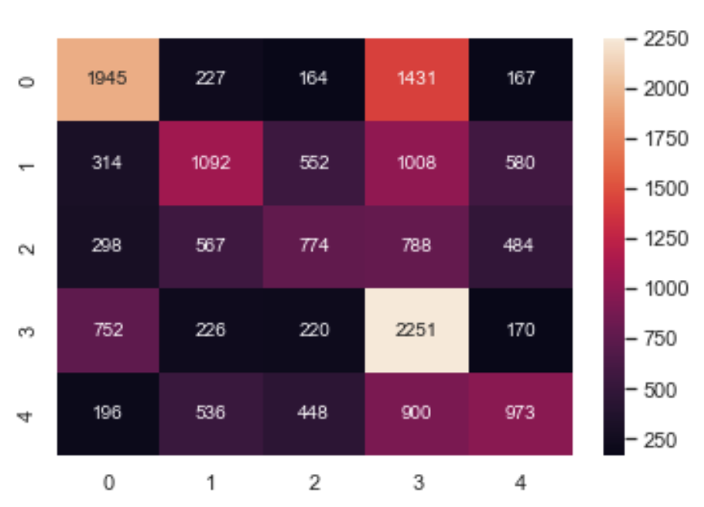
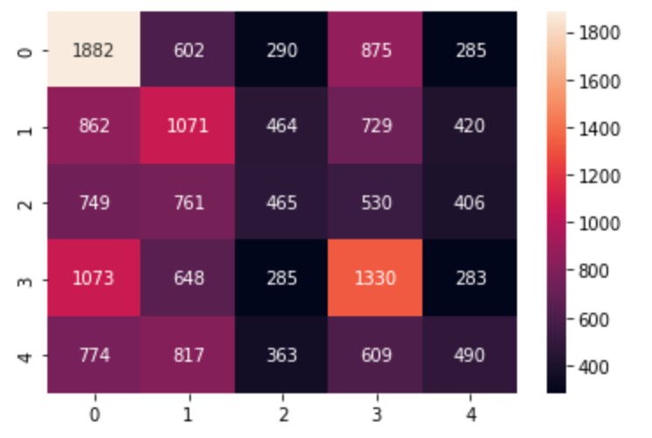
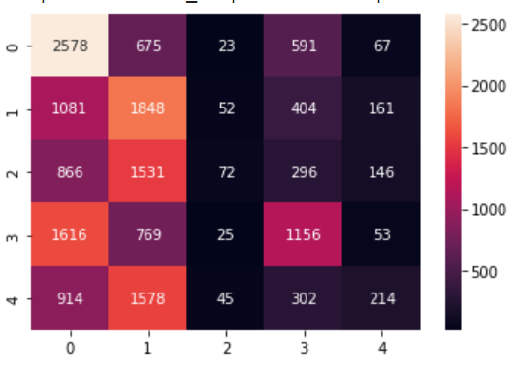
TF-IDF Confusion Matrix
SVM
Random Forest
CNN
Logistic Regression
Simple NN
BiLSTM
Emoji Mapping: 0 - ❤️ 1 - 😂 2 - 😅 3 - 😍 4 - 🙄

Slide 40
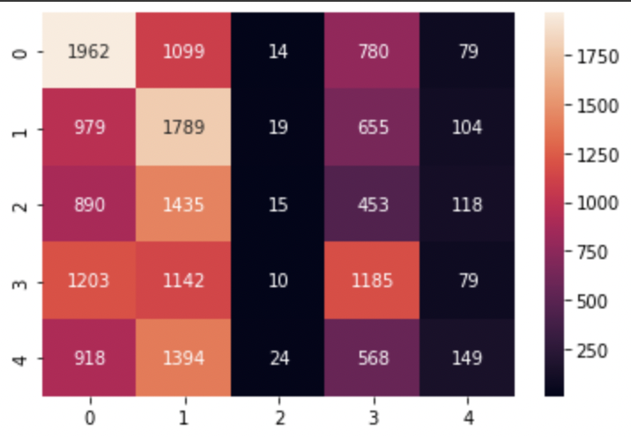
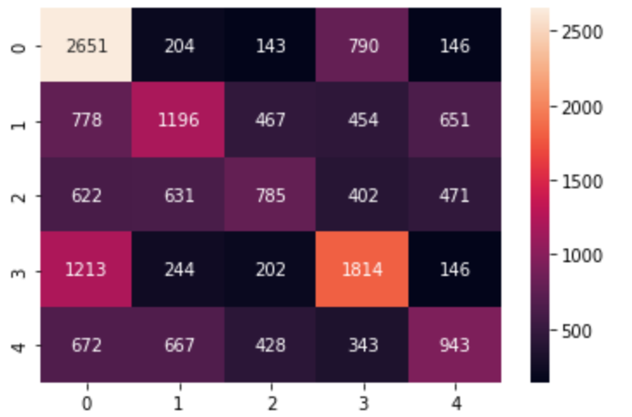
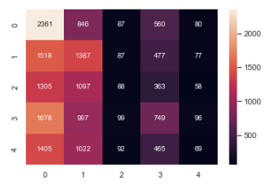
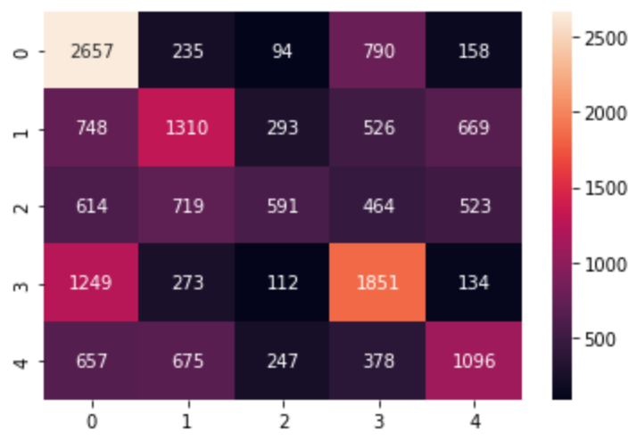
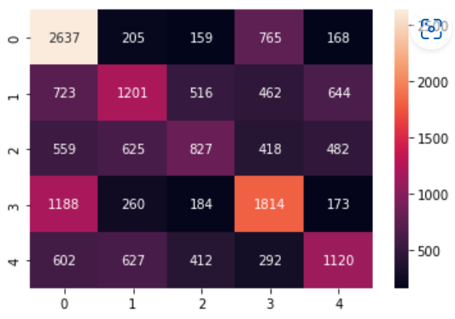
Glove Confusion Matrix
SVM
Random Forest
CNN
Logistic Regression
Simple NN
BiLSTM
Emoji Mapping: 0 - ❤️ 1 - 😂 2 - 😅 3 - 😍 4 - 🙄
Notes:
The glove confusion matrix

Slide 41
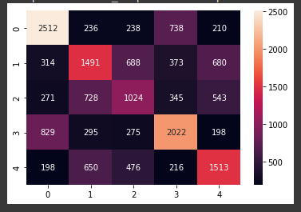
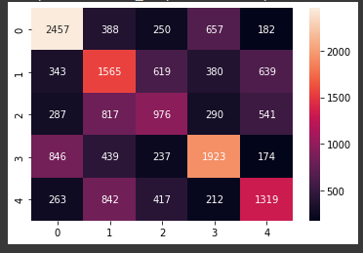
Transfer Learning Confusion Matrix
Bertweet
DistilBert

Slide 42
Macro-Average Scores
 | Precision |  | Recall |  | F1
 | TF-IDF | GLoVe | TF-IDF | GLoVe | TF-IDF | GLoVe
SVM | 0.40 | 0.28 | 0.36 | 0.28 | 0.34 | 0.23
Logistic Regression | 0.42 | 0.24 | 0.40 | 0.25 | 0.40 | 0.21
Random Forest | 0.38 | 0.29 | 0.37 | 0.29 | 0.36 | 0.29
Simple NN | 0.39 | 0.44 | 0.37 | 0.42 | 0.37 | 0.42
CNN | 0.37 | 0.42 | 0.36 | 0.42 | 0.35 | 0.41
BiLSTM | 0.35 | 0.44 | 0.32 | 0.43 | 0.27 | 0.43
Bertweet | 0.49 |  | 0.49 |  | 0.49
DistilBert | 0.48 |  | 0.47 |  | 0.47
Notes:
Since our dataset is relatively well balanced, we use macro average as we want to check the overall scores of each class.

Slide 43
Overall Comparison(Accuracy)
 | TF-IDF | GLoVe
SVM | 37% | 30%
Logistic Regression | 41% | 27%
Random Forest | 39% | 31%
Simple NN | 39% | 44%
CNN | 38% | 43%
BiLSTM | 34% | 45%
Bertweet | 50%
DistilBert | 48%
Notes:
In general we observe that the linear models do not perform as well as the complex models. This maybe due to linear separability issue. So tweets can’t be interpreted using linear models and need more complex models.
For linear models, we observed that the tf-idf performed better than glove whereas for the neural network models, glove performed better than tf-idf.
The difference in performance between the 2 embeddings for various models can be because TFIDF only considers the importance of a word to a particular tweet and does not consider the co-occurrence or the context in which words appear. Glove takes that into consideration and is made for complex models such as the LSTM RNN, and that could be why it produced better results compared to TFIDF, especially for our tweet dataset. The tweets contain a lot of words with semantic differences and with Glove, the neural network can better learn the complex relationships between them than just using term frequency.
Upon comparing the various models, we have discovered that the transfer learning model bertweet performed the best. This maybe due to the large prior knowledge from the pretrained models which the models trained from scratch do not have.

Slide 44
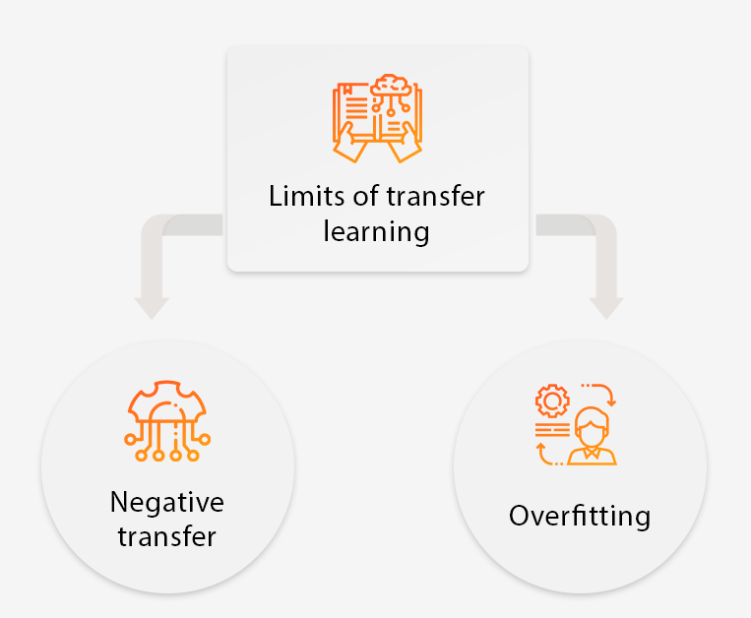
Limitations of using transfer models
Bert trained on wikipedia rather than tweets→ language usage may differ
Network layers cannot be altered in transfer learning→ overfitting can occur when model learns noise and details from training data
Notes:
HOwever here are some limitation due to which our transfer learning model may not have achieved optimal accuracy.
Transfer learning only works if the initial and target problems are similar enough for the first round of training to be relevant. Regardless of how similar developers may think these two sets of training data are, algorithms may not always agree with them. Currently, there are no specific standards on what tasks are related or how algorithms decide which tasks are related, which makes it challenging to find solutions to negative transfer.
In transfer learning, developers cannot remove the network layers to find optimal AI models with confidence, hence overfitting can easily occur. The process to decide how many layers and neurons to remove so that the model does not become overfitting is time-consuming and challenging

Slide 45
06
Reflection
Issues Faced, Learning Points, Future Work

Slide 46
Issues Faced 🤕
Small dataset due to privated/deleted tweets, forgoing tweets with multiple emojis (only used <1% out of 14M)
Long training time for models (e.g. SVM, Transfer Learning)
Slangs/Misspelled words not captured in Glove Embedding
Notes:
Improvements/limitations:
Limiting to english tweets might decrease generalizability in predicting
Can improve by generating predicting emoji likeliness for a sentence rather than just one emoji. Since sentences/tweets are subjective and even humans might suggest different emojis for one particular sentence.

Slide 47
What we learnt 🧑‍🎓
Linear Models + Random Forest
TF-IDF embeddings perform significantly better compared to GLOVE on test set
np.mean() to aggregate word embedding score across a sentence eliminated crucial information
Truncated SVD proved useful in dimensionality reducing sparse matrix reducing overfitting on test data

Slide 48
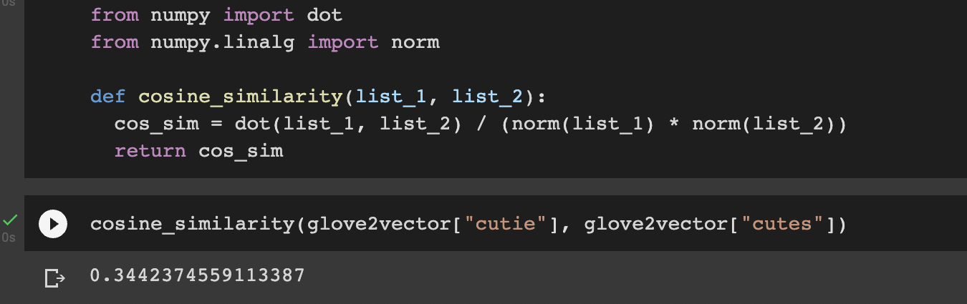
What we learnt 🧑‍🎓
Limitations of Glove Embeddings (Deep Learning)
Usage of slangs (Single word comparison) for 😍
(Smaller cosine(theta) == Larger angle)

Slide 49
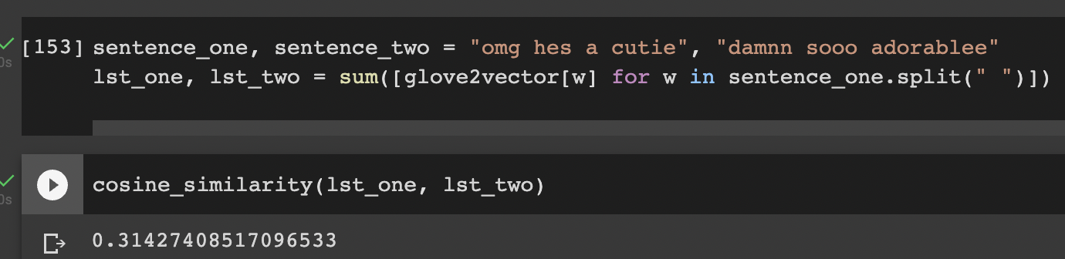
What we learnt 🧑‍🎓
Limitations of Glove Embeddings (Deep Learning)
2) Cosine Similarities across similar Tweets for 😍
(Smaller cosine(theta) == Larger angle)
Notes:
Eliminating patterns among similar tweets, harder for correct classification

Slide 50
Future Work 🔮
Expanding multi-class classification beyond 5 emojis since real world collection far exceeds it
Explore multi-label prediction since most tweets include mixture of emojis
Fine tune embeddings through train own word2vec (CBOW/Skipgram) for Tweets + Hashtags + Emojis

Slide 51
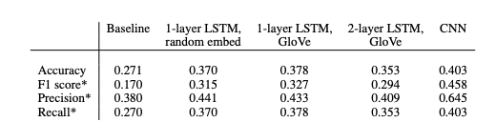
Value Add
Existing research focuses generally on the performance metrics for emoji prediction: https://web.stanford.edu/class/archive/cs/cs224n/cs224n.1174/reports/2762064.pdf
Our project value adds to existing dearth of literature by evaluating different word embeddings on the models (linear model to deep neural network)
Highlight why certain word embeddings work better/worse on each model.

Slide 52
Resources 📚
Colab notebook. (n.d.). Google colaboratory. Google Colab. Retrieved November 26, 2022, from https://colab.research.google.com/drive/1hXIQ77A4TYS4y3UthWF-Ci7V7vVUoxmQ?usp=sharing#scrollTo=T3H0qUZvPOP4
Distilbert. DistilBERT. (n.d.). Retrieved November 26, 2022, from https://huggingface.co/docs/transformers/model_doc/distilbert
Ensemble methods. scikit. (n.d.). Retrieved November 26, 2022, from https://scikit-learn.org/stable/modules/ensemble.html
Horev, R. (2018, November 17). Bert explained: State of the art language model for NLP. Medium. Retrieved November 26, 2022, from https://towardsdatascience.com/bert-explained-state-of-the-art-language-model-for-nlp-f8b21a9b6270
Lendave, V. (2021, October 7). Hands-on guide to word embeddings using glove. Analytics India Magazine. Retrieved November 26, 2022, from https://analyticsindiamag.com/hands-on-guide-to-word-embeddings-using-glove/
Lutkevich, B. (2020, January 27). What is Bert (language model) and how does it work? SearchEnterpriseAI. Retrieved November 26, 2022, from https://www.techtarget.com/searchenterpriseai/definition/BERT-language-model
Mohajon, J. (2021, July 24). Confusion matrix for your multi-class machine learning model. Medium. Retrieved November 26, 2022, from https://towardsdatascience.com/confusion-matrix-for-your-multi-class-machine-learning-model-ff9aa3bf7826
Nguyen, D. Q. (2021, December 27). Bertweet: The first large-scale pre-trained language model for English tweets. VinAI. Retrieved November 26, 2022, from https://www.vinai.io/bertweet-the-first-large-scale-pre-trained-language-model-for-english-tweets/
Nguyen, D. Q., Vu, T., & Nguyen, A. T. (2020, October 5). Bertweet: A pre-trained language model for English tweets. arXiv.org. Retrieved November 26, 2022, from https://arxiv.org/abs/2005.10200
Pennington, J., Socher, R., & Manning, C. D. (n.d.). GloVe: Global Vectors for Word Representation. Glove: Global vectors for word representation. Retrieved November 26, 2022, from https://nlp.stanford.edu/projects/glove/
Notes:
https://www.researchgate.net/publication/350087505_A_Sourceful%27_Twist_Emoji_Prediction_Based_on_Sentiment_Hashtags_and_Application_Source
https://analyticsindiamag.com/hands-on-guide-to-word-embeddings-using-glove/
https://nlp.stanford.edu/projects/glove/
https://towardsdatascience.com/understanding-bert-bidirectional-encoder-representations-from-transformers-45ee6cd51eef
https://towardsdatascience.com/confusion-matrix-for-your-multi-class-machine-learning-model-ff9aa3bf7826
https://towardsdatascience.com/deconstructing-bert-part-2-visualizing-the-inner-workings-of-attention-60a16d86b5c1
https://towardsdatascience.com/bert-explained-state-of-the-art-language-model-for-nlp-f8b21a9b6270
https://towardsdatascience.com/distillation-of-bert-like-models-the-theory-32e19a02641f
https://huggingface.co/docs/transformers/model_doc/distilbert
https://medium.com/huggingface/distilbert-8cf3380435b5
https://colab.research.google.com/drive/1hXIQ77A4TYS4y3UthWF-Ci7V7vVUoxmQ?usp=sharing#scrollTo=T3H0qUZvPOP4
https://www.techtarget.com/searchenterpriseai/definition/BERT-language-model
https://www.vinai.io/bertweet-the-first-large-scale-pre-trained-language-model-for-english-tweets/
https://arxiv.org/abs/2005.10200
https://web.stanford.edu/class/archive/cs/cs224n/cs224n.1174/reports/2762064.pdf
https://mljar.com/blog/visualize-decision-tree/
https://towardsdatascience.com/random-forest-hyperparameters-and-how-to-fine-tune-them-17aee785ee0d
https://scikit-learn.org/stable/modules/ensemble.html

Slide 53
Resources 📚
Płoński, P. (2020, June 22). Visualize a decision tree in 4 ways with Scikit-Learn and python. MLJAR. Retrieved November 26, 2022, from https://mljar.com/blog/visualize-decision-tree/
Reboul, R. O. (2021, December 10). Distillation of bert-like models: The theory. Medium. Retrieved November 26, 2022, from https://towardsdatascience.com/distillation-of-bert-like-models-the-theory-32e19a02641f
Sanh, V. (2020, August 31). 🏎 smaller, faster, cheaper, lighter: Introducing Dilbert, a distilled version of Bert. Medium. Retrieved November 26, 2022, from https://medium.com/huggingface/distilbert-8cf3380435b5
Thorn, J. (2021, September 26). Random Forest: Hyperparameters and how to fine-tune them. Medium. Retrieved November 26, 2022, from https://towardsdatascience.com/random-forest-hyperparameters-and-how-to-fine-tune-them-17aee785ee0d
Vajpayee, S. (2020, August 6). Understanding Bert - (bidirectional encoder representations from transformers). Medium. Retrieved November 26, 2022, from https://towardsdatascience.com/understanding-bert-bidirectional-encoder-representations-from-transformers-45ee6cd51eef
Venkit, P. (2021, March). A `sourceful' twist: Emoji Prediction based on sentiment, hashtags and ... Research Gate. Retrieved November 26, 2022, from https://www.researchgate.net/publication/350087505_A_Sourceful'_Twist_Emoji_Prediction_Based_on_Sentiment_Hashtags_and_Application_Source
Vig, J. (2022, April 20). Deconstructing Bert, part 2: Visualizing The inner workings of attention. Medium. Retrieved November 26, 2022, from https://towardsdatascience.com/deconstructing-bert-part-2-visualizing-the-inner-workings-of-attention-60a16d86b5c1
Zhao, L., & Zeng, C. (n.d.). Using Neural Networks to Predict Emoji Usage from Twitter Data. Stanford CS 224N | Natural Language Processing with Deep Learning. Retrieved November 26, 2022, from https://web.stanford.edu/class/archive/cs/cs224n/cs224n.1214/
Notes:
https://www.researchgate.net/publication/350087505_A_Sourceful%27_Twist_Emoji_Prediction_Based_on_Sentiment_Hashtags_and_Application_Source
https://analyticsindiamag.com/hands-on-guide-to-word-embeddings-using-glove/
https://nlp.stanford.edu/projects/glove/
https://towardsdatascience.com/understanding-bert-bidirectional-encoder-representations-from-transformers-45ee6cd51eef
https://towardsdatascience.com/confusion-matrix-for-your-multi-class-machine-learning-model-ff9aa3bf7826
https://towardsdatascience.com/deconstructing-bert-part-2-visualizing-the-inner-workings-of-attention-60a16d86b5c1
https://towardsdatascience.com/bert-explained-state-of-the-art-language-model-for-nlp-f8b21a9b6270
https://towardsdatascience.com/distillation-of-bert-like-models-the-theory-32e19a02641f
https://huggingface.co/docs/transformers/model_doc/distilbert
https://medium.com/huggingface/distilbert-8cf3380435b5
https://colab.research.google.com/drive/1hXIQ77A4TYS4y3UthWF-Ci7V7vVUoxmQ?usp=sharing#scrollTo=T3H0qUZvPOP4
https://www.techtarget.com/searchenterpriseai/definition/BERT-language-model
https://www.vinai.io/bertweet-the-first-large-scale-pre-trained-language-model-for-english-tweets/
https://arxiv.org/abs/2005.10200
https://web.stanford.edu/class/archive/cs/cs224n/cs224n.1174/reports/2762064.pdf
https://mljar.com/blog/visualize-decision-tree/
https://towardsdatascience.com/random-forest-hyperparameters-and-how-to-fine-tune-them-17aee785ee0d
https://scikit-learn.org/stable/modules/ensemble.html

Slide 54


THANK
YOU!

